Slide 1

AI Code Explainer: An Intelligent Platform for Code Interpretation Using Gemini Flash 2.0
By:-
SK.INTHIYAZ [245323748115]
B.RAJESH [245323748077]
V.MANASWI REDDY [245323748120]

Slide 2
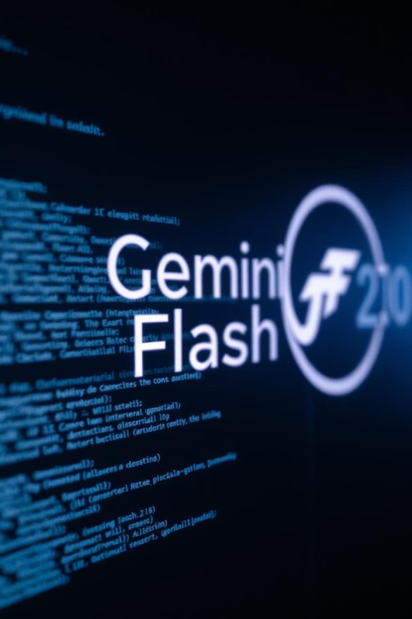
AI Code Explainer: An Intelligent Platform for Code Interpretation Using Gemini Flash 2.0
Revolutionizing code understanding for developers and learners.
Harnessing advanced AI for accessible programming education and debugging. Built as a responsive web-based platform.

Slide 3

Technical Architecture Overview
Frontend
Backend
interface.
BuiltwithReact.js for a fast, modern user
Node.jswithExpress.js managing API requests and user
authentication.
AI Integration
Scalability
Designed for cloud-native deployment (e.g., Google Cloud Platform) to handle high traffic.
SecureRESTfulAPIcalls to the Gemini Flash 2.0 service.

Slide 4
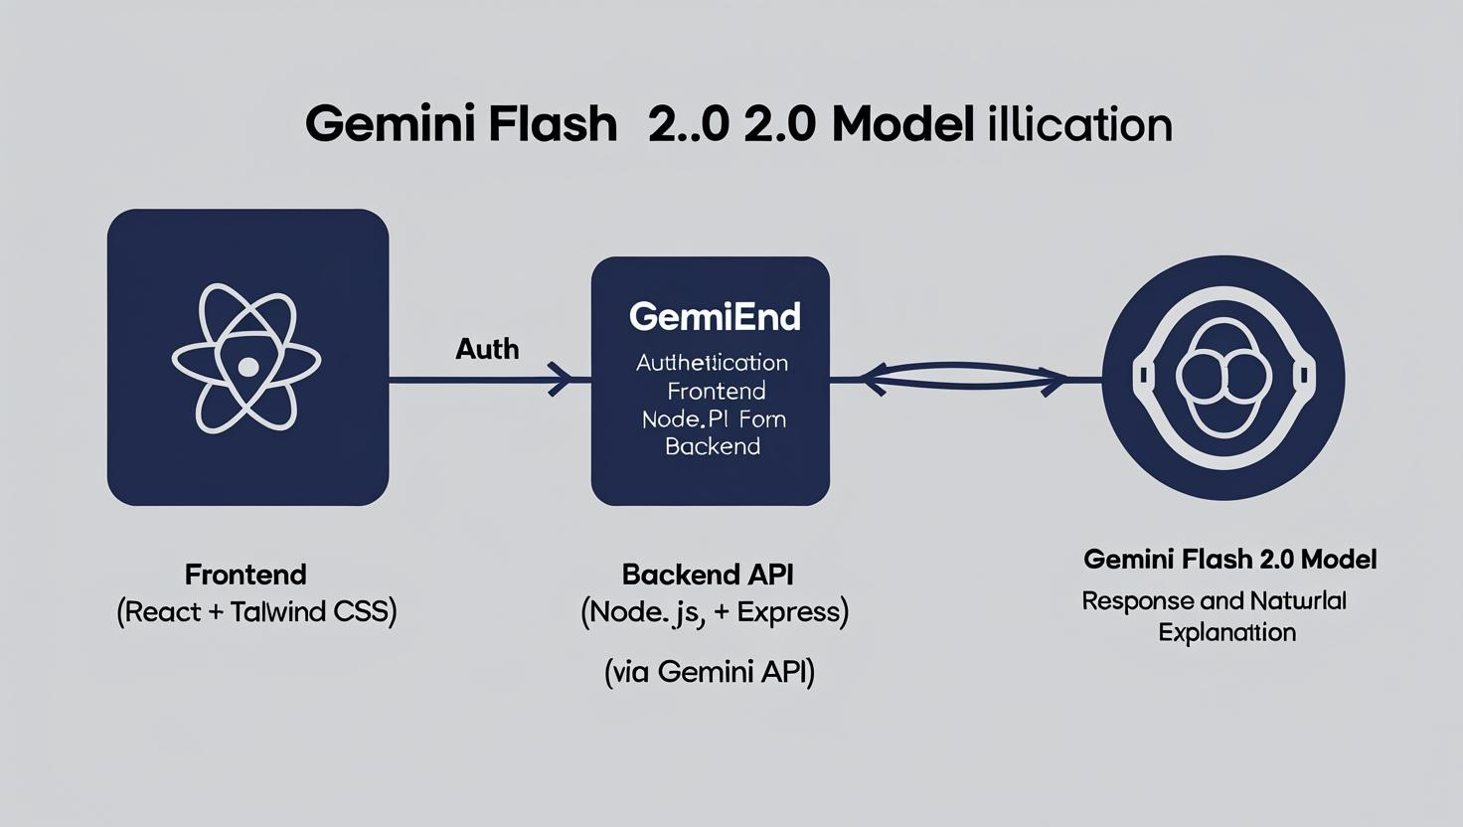

Slide 5
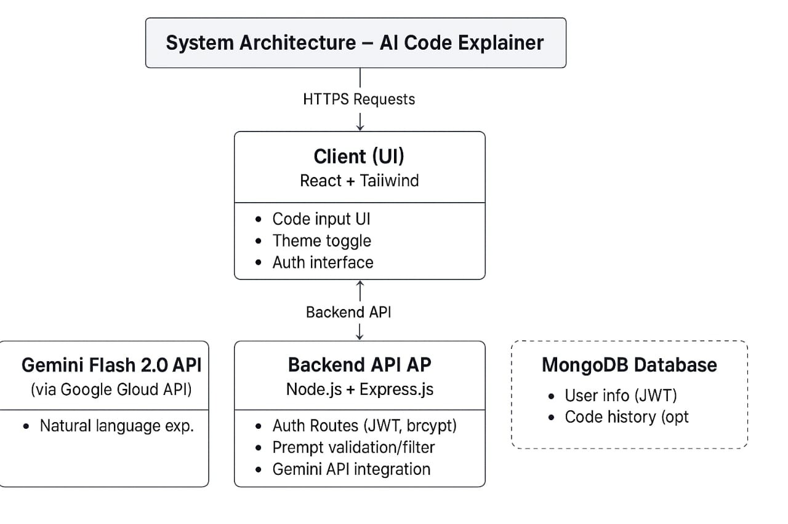

Slide 6
Methodology
Technology Stack:-
Frontend:
React.js: Chosen for its component-based architecture and dynamic user interface rendering.
Tailwind CSS: A utility-first CSS framework used for styling and implementing responsive designs with dark/light mode support.
JavaScript (ES6+): Core scripting language for frontend logic and interactivity.
Backend:
Node.js with Express.js: Used for building RESTful APIs to handle user requests, authentication, and communication with the AI model.
Authentication:
JWT (JSON Web Tokens): Enables secure, stateless user session management.
bcrypt: Ensures password hashing and secure user authentication.
AI Integration:
Gemini Flash 2.0 API: A large language model that receives source code as input and returns structured natural language explanations.
Input Filtering:
Regex and Keyword Matching: Lightweight techniques used to identify and handle non-code or irrelevant inputs before sending them to the AI model.

Slide 7

The Intelligence Behind the Explanations: Gemini Flash 2.0
Powered by
Google'scutting-edge Gemini Flash 2.0 language model.
Optimized for
High-speed,high-accuracy code analysis and explanation.
Performance
Achievessub-2-second explanation generation for typical 500-line
Python scripts.
Contextual Awareness
Interpretscodewithinitssurrounding project structure.

Slide 8
Introduction: Unlocking Code Understanding
Problem:
Developers and learners face steeplearning (this was a typographical error) curves with new codebases.
Solution:
AI Code Explainer provides clear, natural language
code interpretations.
Core Purpose:
To democratize programming knowledge and accelerate learning.
Facilitates understanding of complex algorithms and
unfamiliar syntax.

Slide 9
Intuitive Code Interpretation Features
Code Interpretation
Responsive Design Authentication Dark/Light Mode Prompt Filtering
Explains logicand functionsofinput code.
Works seamlessly across devices and screen sizes. Secure user login and registration with JWT. Toggle available for user comfort. Identifies and responds to off-topic or irrelevant user
inputs.

Slide 10

User Experience & Accessibility
Clean UI
Responsivewebinterfaceforseamlessexperience on desktop and mobile.
Accessibility Modes
Featuresdarkandlightmodesto suit user preferences.
Robust Input Handling
Provides instructivefeedbackfor irrelevant inputs (e.g., "Please
provide valid code").
Secure Access
Implementsuserauthentication for personalized history and settings.

Slide 11
Target Audience & Key Applications
Developers
Accelerates on boarding to new projects and understanding legacy code.
Students & Learners
Debugging Aid
Efficiency
Simplifies complex programming concepts; aids in self-study.
Helps to identify logical flows and potential issues in unfamiliar code.
Expected to reduce time
spent on code comprehension by 30% for new developers.

Slide 12
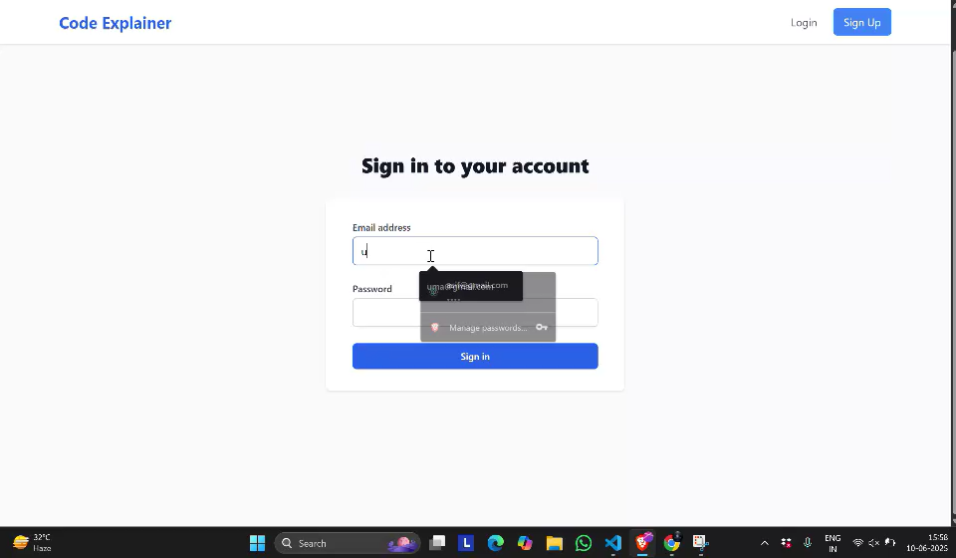
AI CODE EXPLAINER Execution

Slide 13
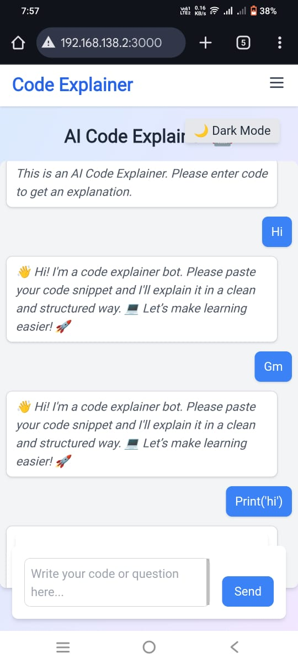
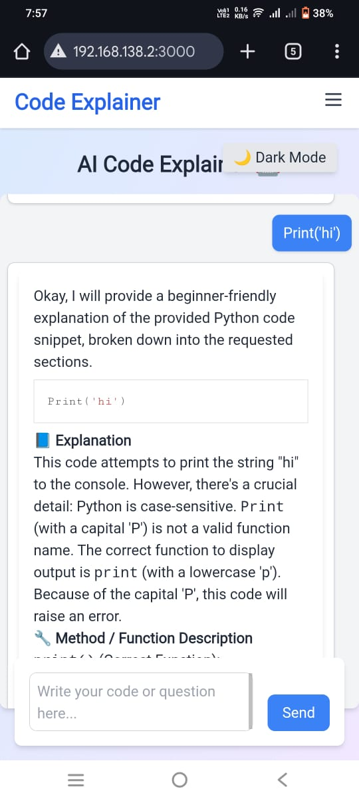
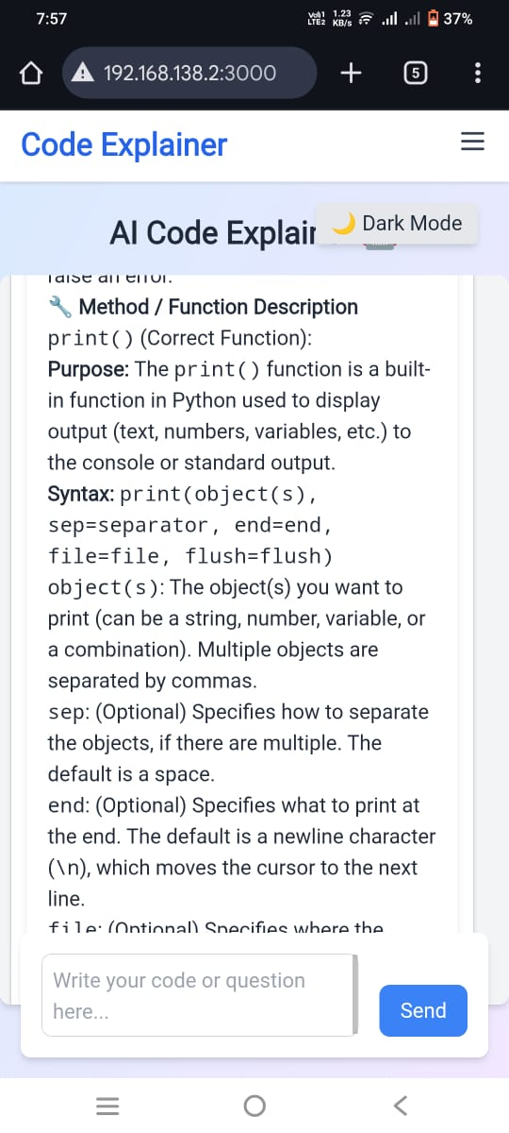

Slide 14

Conclusion: The Future of Code Comprehension
Recap: Anintelligent, accessibleplatformtransformingcode
interpretation.
Impact: Bridgingthe gap between codeand human understanding.
Future Vision: Expanding language support to 50+ programming languages; integrating with popular IDEs.
Call to Action: Experience the future of programming with AI Code
Explainer.

Slide 15


